Slide 1
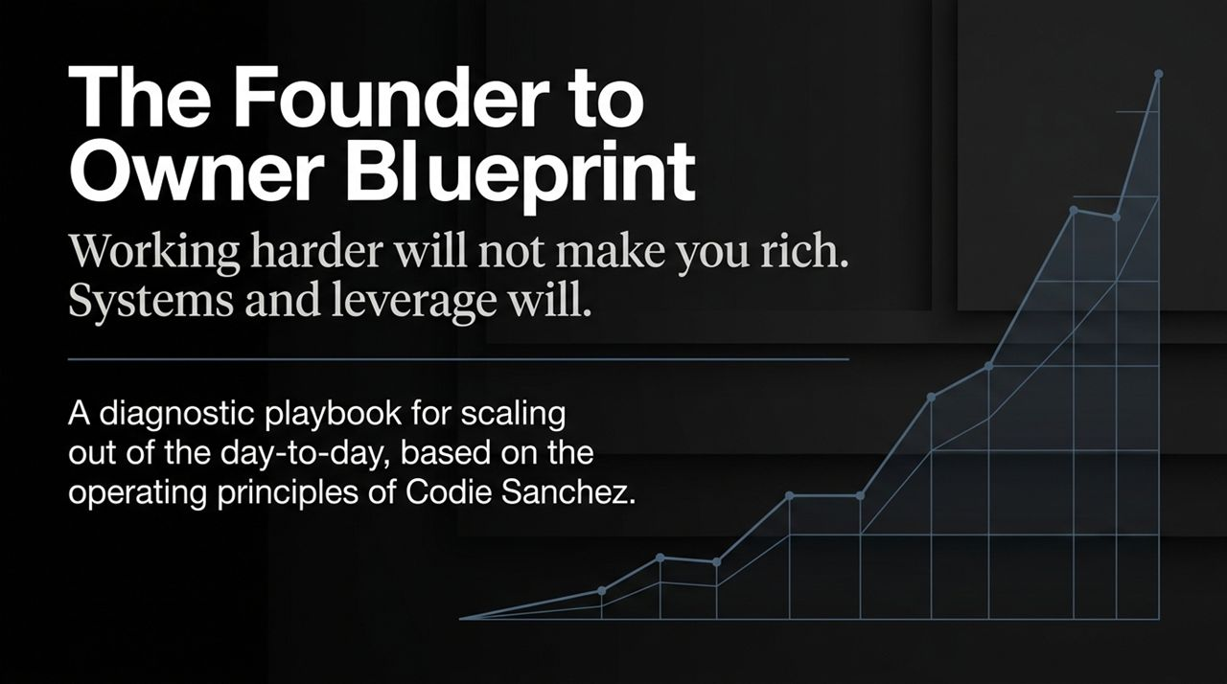
Notes:
Introduction: Welcome everyone. Today we are addressing the fundamental bottleneck that stops most businesses from scaling: the transition from being a overworked founder to a true business owner.
The Core Thesis: Working harder will not make you rich. If hard work alone produced wealth, every small business owner working 80-hour weeks would be a multimillionaire. True wealth and scale come from systems and leverage.
Objective: This session is a diagnostic playbook based on the operating principles of Codie Sanchez. We will dissect why founders get trapped in the day-to-day operations and provide a concrete framework to build a business that operates independently of your manual labor.
https://www.youtube.com/watch?v=2d4u80LmRQ8

Slide 2
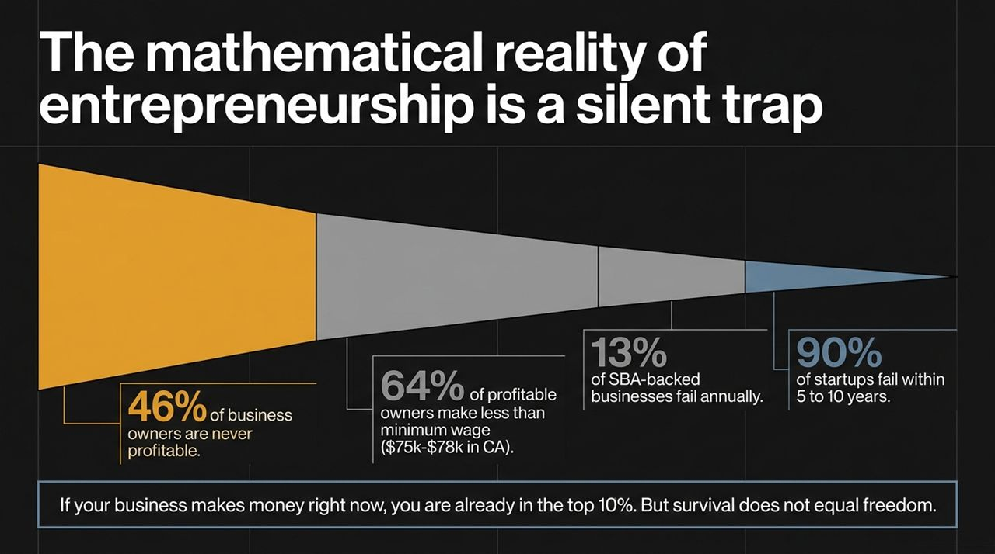
Notes:
The Trap: Most people enter business seeking freedom, but mathematically, entrepreneurship is a silent trap.
Data Breakdown:
46% of business owners are never profitable.
64% of profitable owners make less than minimum wage (roughly $75k–$78k in high-cost states). They are taking on 100% of the risk for less compensation than a mid-level corporate employee.
13% of SBA-backed businesses fail annually, and 90% of traditional startups fail within 5 to 10 years.
Key Takeaway: If your business is currently making money, you are already in the top 10%. However, survival is not freedom. Survival without systems just buys you a grueling, high-stress job where you are your own worst boss.

Slide 3
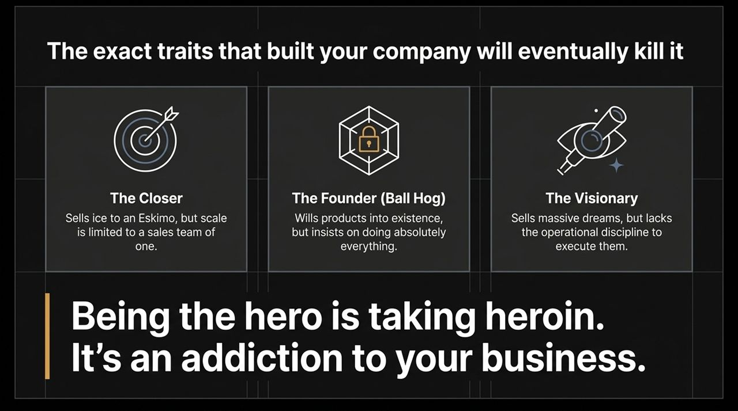
Notes:
The Paradox: The exact psychological traits that allow you to bring a company into existence are the very traits that will eventually kill its ability to scale.
Three Archetypes:
The Closer: Highly skilled at sales. They can sell anything to anyone, but because they are the sole revenue driver, the sales team maxes out at a capacity of one.
The Founder / Ball Hog: Wills products into existence through sheer grit. However, they insist on controlling every operational nuance because nobody else can do it right.
The Visionary: Sells massive, inspiring dreams to investors and clients but lacks the operational discipline and systems to execute consistently.
The Warning: As Codie Sanchez notes, Being the hero is taking heroin. It's an addiction to your business. Being indispensable isn't a badge of honor—it's an operational failure.

Slide 4
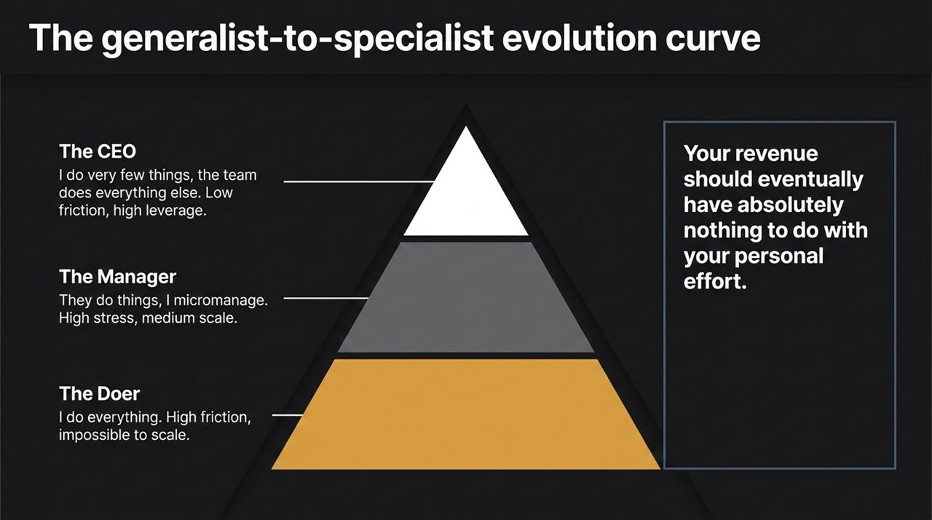
Notes:
The Transition Hierarchy: To escape the trap, you must understand your position on the evolution curve.
The Doer (Bottom Tier): I do everything. High friction, maximum personal effort, zero leverage. Impossible to scale.
The Manager (Middle Tier): They do things, I micromanage. You hire hands, but because you lack trust or clear systems, you spend all day managing inputs rather than outcomes. High stress, medium scale.
The CEO / Owner (Top Tier): I do very few strategic things; the team and systems execute everything else. Low personal friction, high financial leverage.
Goal: Your ultimate goal is to decouple your revenue completely from your personal hourly output.

Slide 5
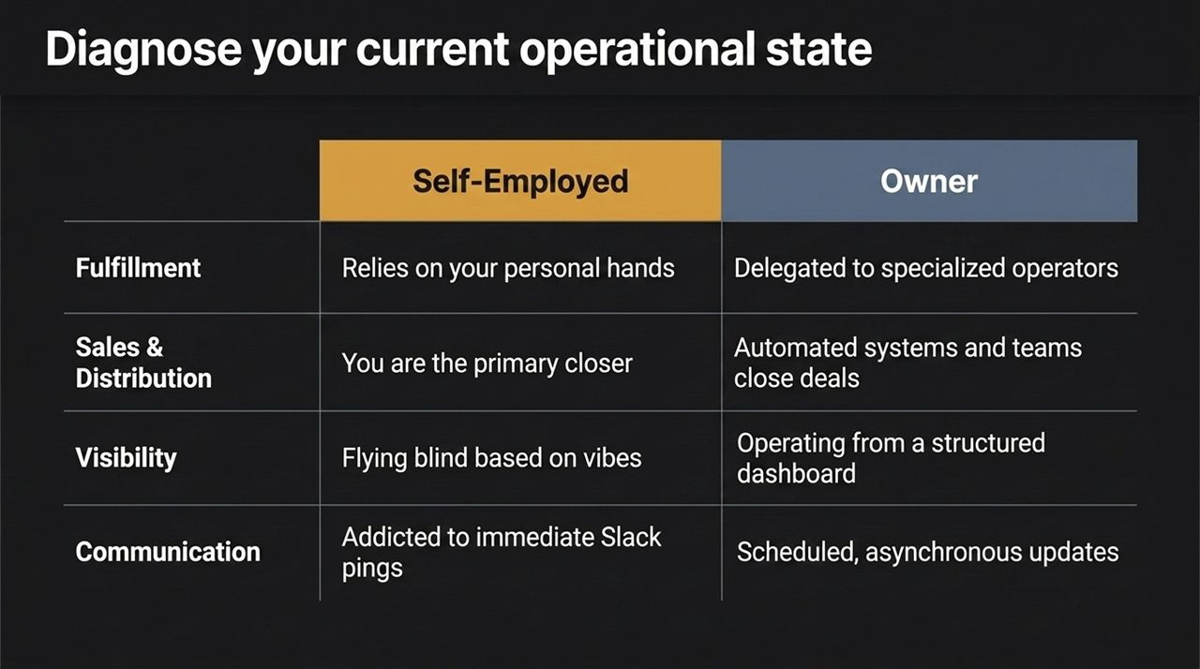
Notes:
Self-Audit: Let's run a quick diagnostic across four core operational pillars.
1. Fulfillment: Are you hands-on in delivering the service/product (Self-Employed), or is fulfillment completely delegated to specialized operators using standard SOPs (Owner)?
2. Sales & Distribution: Does revenue generation rely on your personal ability to close deals, or do you have automated systems and dedicated sales teams closing revenue?
3. Visibility: Are you flying blind based on vibes and bank account balances, or are you managing the company daily via a structured metrics dashboard?
4. Communication: Are you interrupted constantly by immediate Slack pings and fire-fighting, or do you operate on scheduled, asynchronous operational reviews?

Slide 6
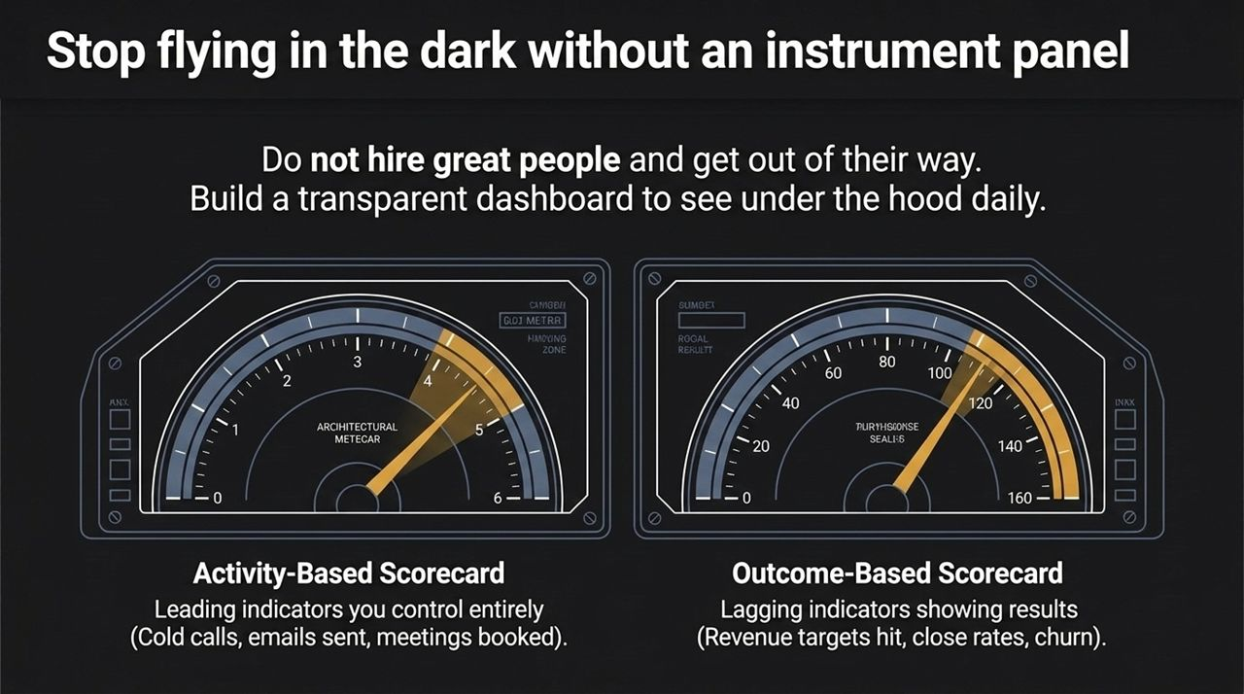
Notes:
The Operational Dashboard: Most founders manage by intuition until a crisis occurs. Do not simply hire great people and get out of their way without visibility. You need a transparent operational instrument panel.
Dual Scorecards:
Activity-Based Scorecard (Leading Indicators): Metrics under your team’s direct control—cold calls made, outreach emails sent, client touchpoints completed, meetings booked.
Outcome-Based Scorecard (Lagging Indicators): Financial and performance results—revenue closed, customer acquisition cost (CAC), close rates, and retention/churn.
Managing activity ensures predictable outcomes before lagging indicators show a drop in revenue.

Slide 7
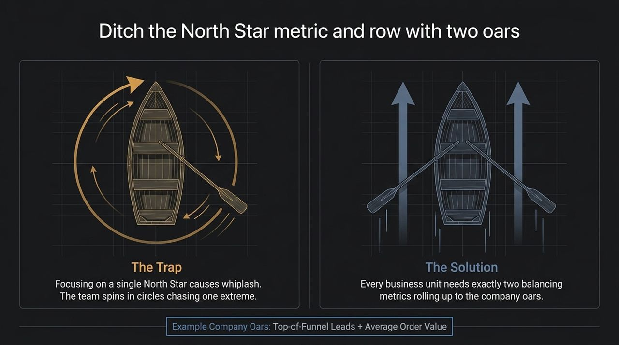
Notes:
The Single North Star Trap: A common piece of advice is to focus on a single North Star metric. In practice, single-metric focus creates operational whiplash. If you tell a team to focus solely on lead volume, quality collapses. If you tell them to focus solely on profitability, growth stalls.
The Two-Oar Solution: Every department and business unit must be governed by two balancing metrics.
Analogy: Pulling one oar spins the boat in circles. Pulling two balanced oars drives the business straight forward.
Example: Pair Top-of-Funnel Lead Generation with Average Order Value / Lead Quality. Balance Speed of Service with Customer Retention Rate.

Slide 8
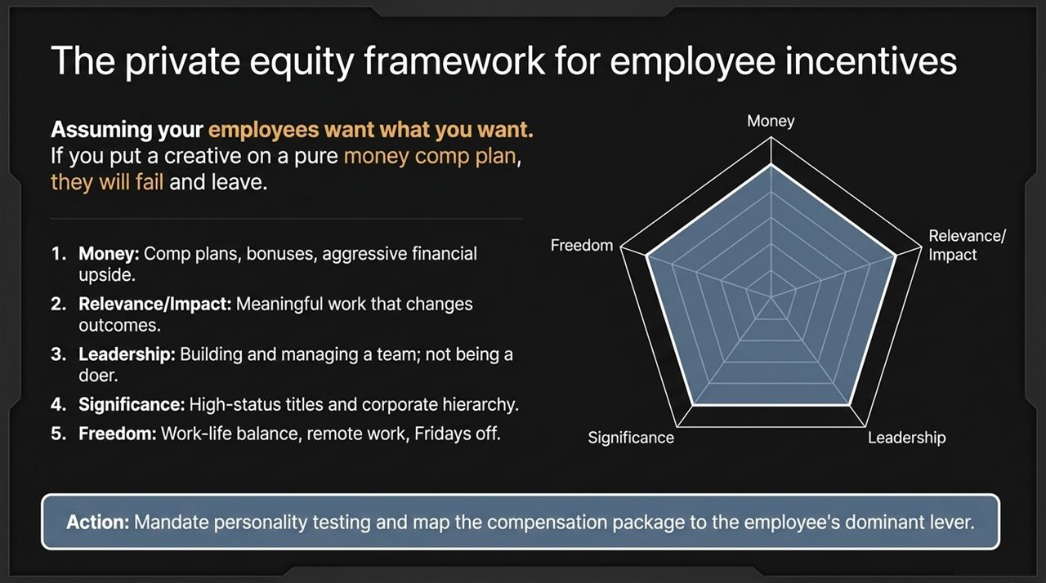
Notes:
The Alignment Problem: A major mistake founders make is assuming employees want what the founder wants (usually cash upside or equity). If you put a creative designer on a pure commission sales plan, they will burn out and quit.
The 5 Human Incentive Levers:
Money: Direct monetary upside, aggressive bonuses, commission structures.
Relevance / Impact: Knowing their work meaningfully changes client or company outcomes.
Leadership: Autonomy to build, manage, and scale a division or team.
Significance: Status, titles, prestige, and recognized standing.
Freedom: Flexibility, work-life balance, remote options, results-oriented culture.
Action: Profile key hires using personality/incentive mapping and tailor compensation to their dominant driver.

Slide 9
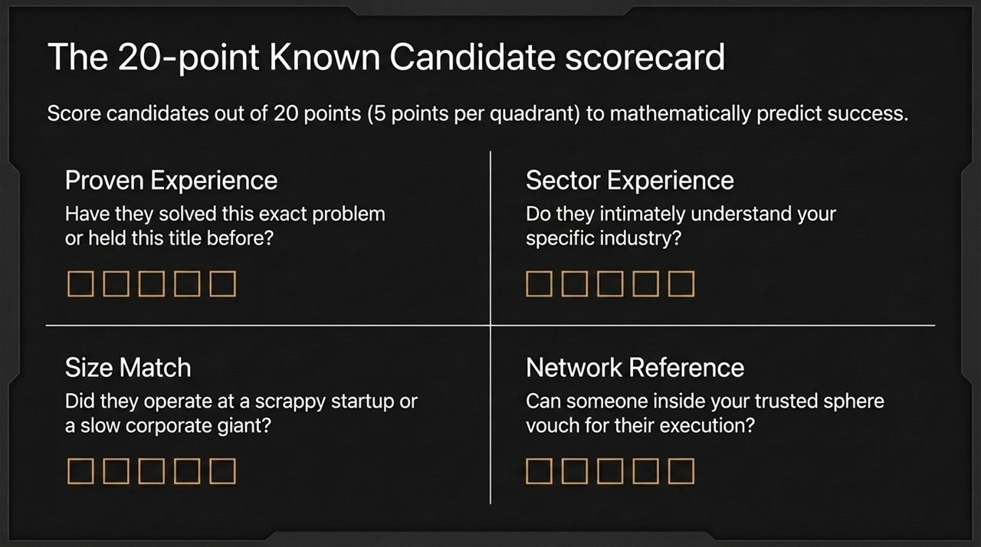
Notes:
De-Risking Hiring: Hiring by gut feeling leads to costly mismatches. Use a structured 20-point scorecard (5 points per quadrant) to evaluate candidates objectively.
1. Proven Experience (5 Pts): Have they solved this exact operational problem before?
2. Sector Experience (5 Pts): Do they intimately understand the dynamics and nuances of your specific industry?
3. Size Match (5 Pts): Have they operated at your current revenue scale? (An executive from a $100M corporation will often fail in a scrappy $2M business).
4. Network Reference (5 Pts): Can trusted leaders in your network vouch directly for their execution?

Slide 10
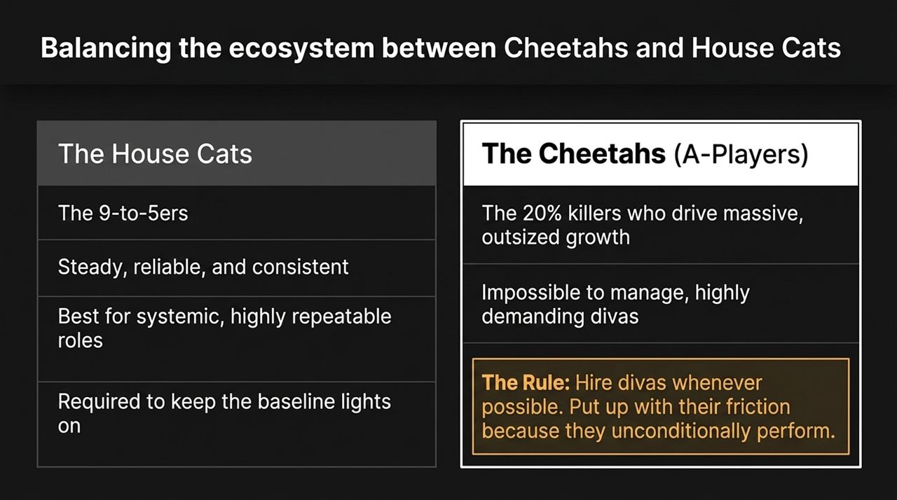
Notes:
Ecosystem Dynamics: A functional business requires two distinct categories of talent.
The House Cats: Reliable 9-to-5 performers. They thrive on routine, stability, and process. They keep the baseline operational lights on and execute repeatable processes smoothly.
The Cheetahs (A-Players / Divas): The 20% who drive 80% of outsized growth. They are intense, demanding, high-maintenance, and often difficult to manage.
The Rule: Hire Cheetahs whenever you need rapid growth. Manage the friction they bring because their performance drives the company forward. Balance them with House Cats to maintain operational stability.

Slide 11
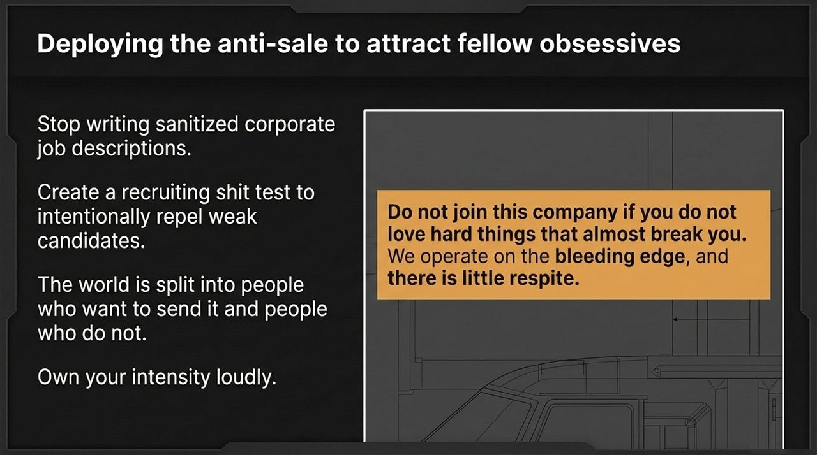
Notes:
Attracting the Right Talent: Generic, sanitized corporate job descriptions attract passive, low-intensity candidates.
The Strategy: Deploy an anti-sale or a recruiting filter designed to intentionally repel low-performers and attract hyper-driven obsessives.
Example Positioning: Do not join this company if you do not love hard problems that demand your absolute best. We operate on the bleeding edge, and expectations are relentless.
Outcome: Filter for candidates who thrive on high accountability and intensity early in the hiring pipeline.

Slide 12

Notes:
The Pricing Trap: Founders frequently underprice their offerings because they anchor prices to their personal bank accounts or spending habits.
Data: Professional pricing studies show executives routinely underprice by 15% due to personal bias. Lower-level employees will price services up to 30% lower if left unchecked.
Value-Based Pricing: Shift from cost-plus pricing to value-captured pricing. Calculate the exact financial value or savings created for the client, and price to capture 10% to 30% of that total value. Disconnect pricing decisions from personal affordability.

Slide 13
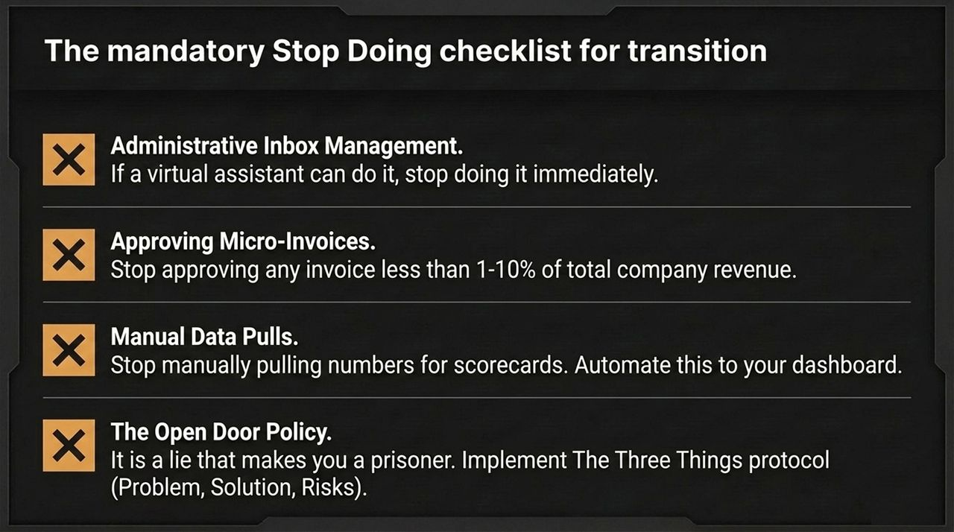
Notes:
Reclaiming Time: Scaling requires systematically eliminating low-leverage tasks.
1. Administrative Inbox Management: Delegate email screening completely to an assistant or automated routing.
2. Micro-Invoice Approvals: Stop approving minor expenses. Set clear budget thresholds (e.g., department heads approve anything under 1–10% of revenue).
3. Manual Data Pulls: Automate reporting so metrics populate live on your central dashboard.
4. Eliminating the Open-Door Policy: Replace unstructured interruptions with the Three Things Protocol (When bringing an issue, staff must present: The Problem, The Proposed Solution, and Potential Risks).

Slide 14
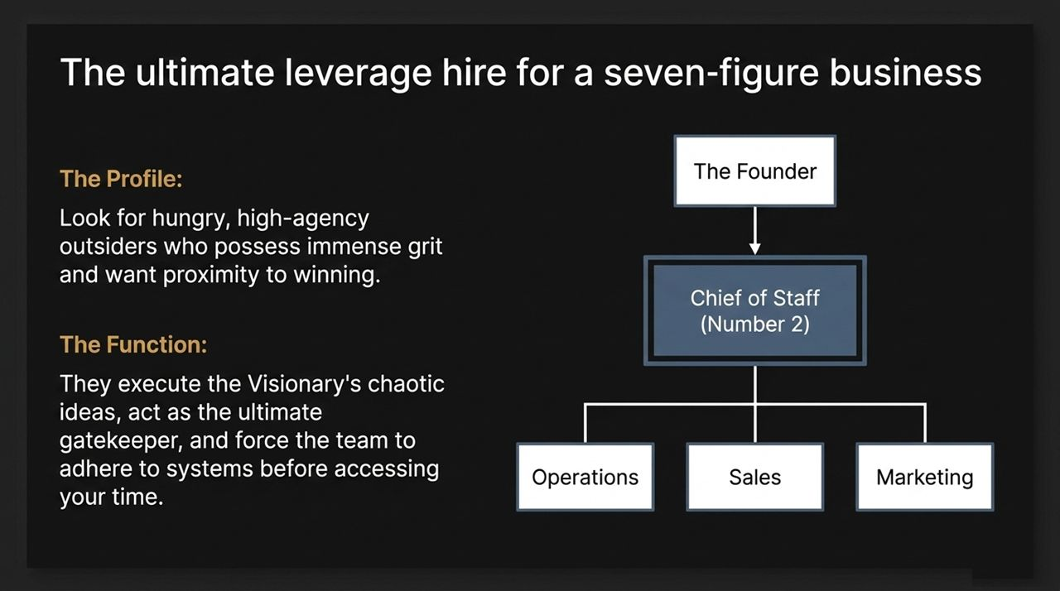
Notes:
The Key Hire: For a seven-figure business, the highest-leverage addition is a high-agency Chief of Staff (Number 2).
Candidate Profile: Look for hungry, high-execution individuals with immense grit who desire direct proximity to business leadership.
Function: They bridge the gap between visionary strategy and operational execution. They structure chaotic ideas into actionable projects, act as an operational gatekeeper, and enforce accountability across Operations, Sales, and Marketing before issues reach the owner.

Slide 15
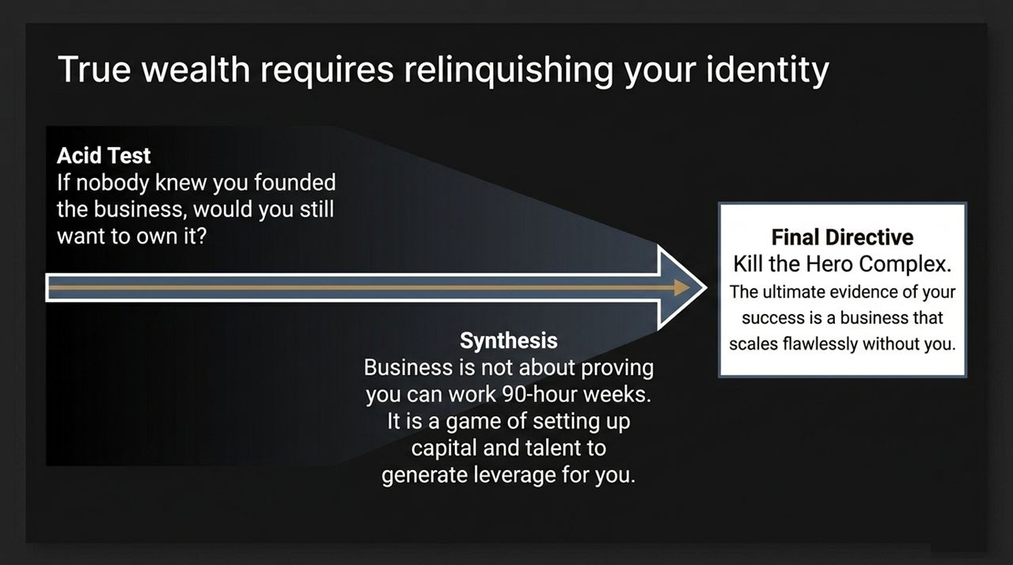
Notes:
Psychological Shift: The primary hurdle to achieving true ownership is ego. Founders often tie their personal identity to being needed daily.
The Acid Test: If nobody knew you owned or founded this business, would you still want to own it purely as an asset?
Synthesis: Business is an engine designed to deploy capital and talent to generate returns with maximum leverage.
Final Directive: Kill the hero complex. The true measure of business success is an enterprise that scales seamlessly in your absence.

Slide 16
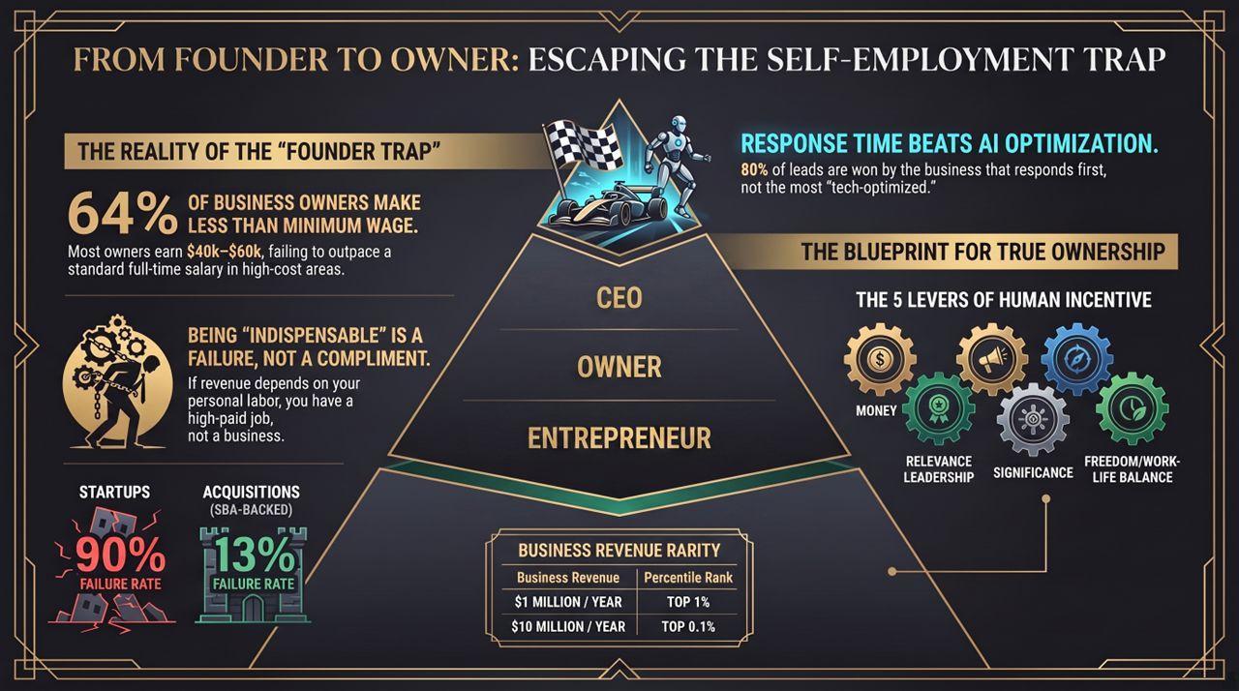
Notes:
Core Contrasts:
Income Reality: 64% of owners earn less than standard employee wages by remaining trapped in low-leverage execution.
Indispensability: Being essential to daily operations is an architecture flaw, not an achievement.
Acquisitions vs. Startups: SBA-backed business acquisitions carry a ~13% failure rate versus ~90% for early-stage startups.
Closing Action Items: Align employee incentives across the 5 levers, install dual-metric dashboards, hire an operational Number 2, and transition your role from active worker to strategic owner.

